Slide 1
SBI - Voice Biometrics
Sourabh Kumar Janghel

Slide 2
HELLO!
I am Sourabh Kumar Janghel
This Presentation contains detailed representation of the POC submitted at Techgig for SBI Hackathon .
You can find me at sourabh.kumar.janghel@outlook.com

Slide 3
Description Of Solution
1
Description of what the Team has tried to build

Slide 4
THE PROCESS
Enroll Voices
Uploading Voices
Matching Voice

Slide 5
ROADMAP – ENROLL
Read the Audio with name
Save this embedding object for further calculations
Create Embeddings using pre-trained models
1
3
5
2
4
6
Read either a single voice sample or from a directory
Create a dictionary of names and their embeddings which can be one name with many embeddings
Upload this to Azure container

Slide 6
ROADMAP – MATCHING
Load the new audio
Download and load the embedding collection from enroll process
Download all voice samples for this name detected of the speaker from distance similarity
1
3
3
5
2
4
6
Extract embedding using pre-trained models
Do distance similarity to get the lowest score match of voice from the collection of embeddings
Do Voice verification and matching against these voice and the voice given to get a final score

Slide 7
Architecture
2
High-level implementation / Solution diagram

Slide 8
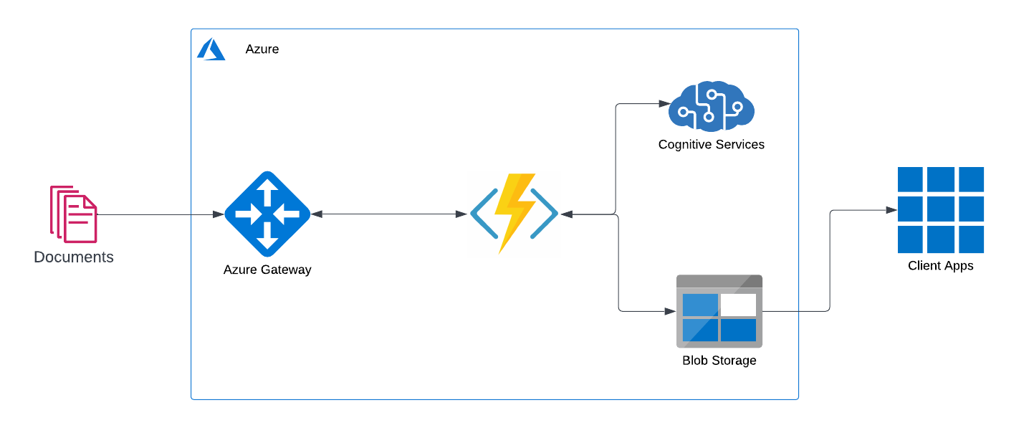

Slide 9
Tech Stack
3
Tools, Technology Stack (including the APIs consumed), and framework details

Slide 10
TECH STACK ANALYSIS
Tools
Python 3.9
APIs
Azure Functions
Azure Containers
Storage
Speechbrain
FFMPEG
Transformers
Framework

Slide 11
Algorithms
4
The algorithms / machine learning models that have been used in the Hackathon prototype

Slide 12
USED Algorithms
speechbrain
torchaudio
speechbrain
transformers
pydub
azure-storage-blob
azurebatchload

Slide 13

A PICTURE IS WORTH A THOUSAND WORDS
A complex idea can be conveyed with just a single still image.
Namely making it possible to absorb large amounts of data quickly.

Slide 14
Output
5
Test cases and corresponding processed output file(s) along with the output time

Slide 15
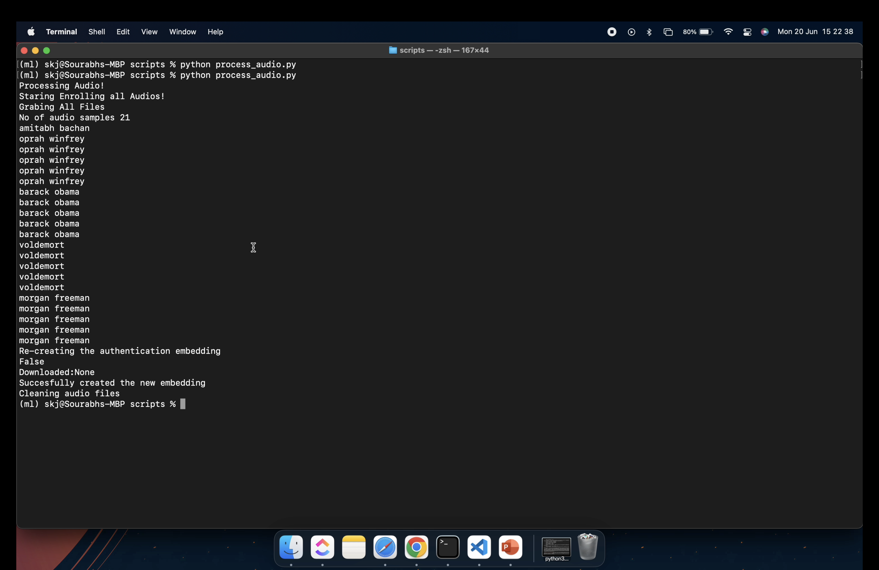
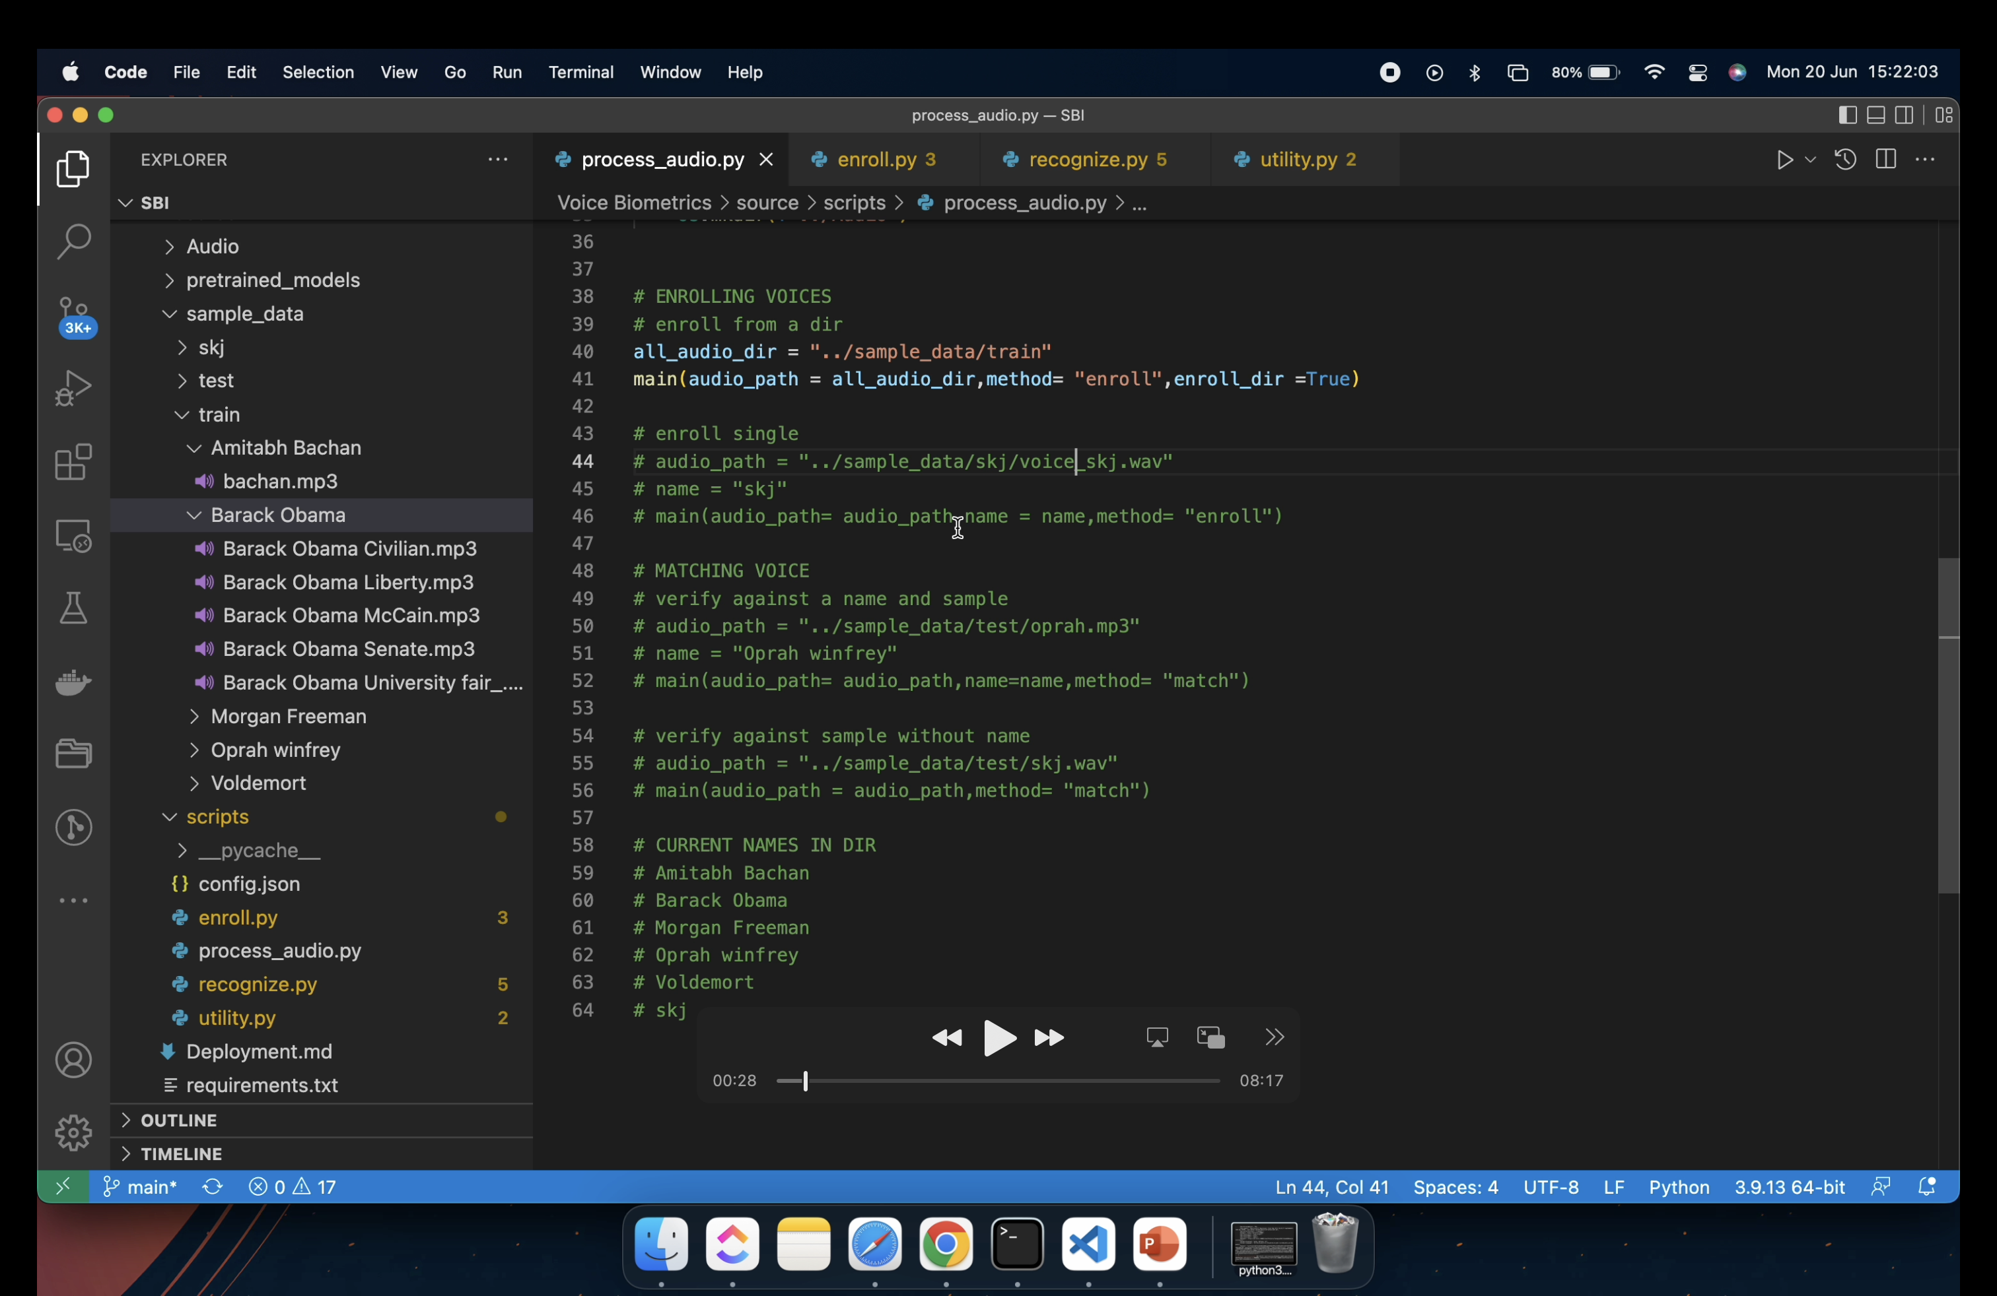
Enroll Voices from a Directory

Slide 16
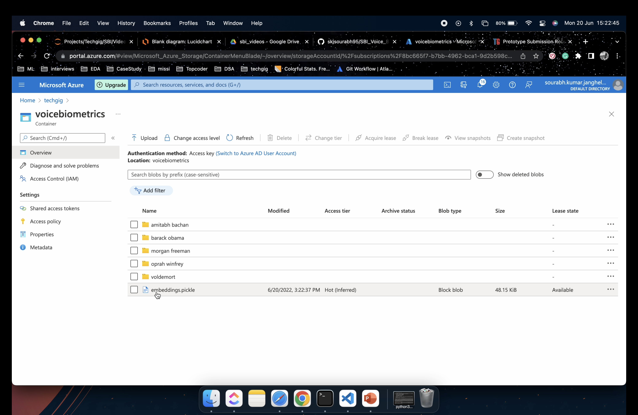
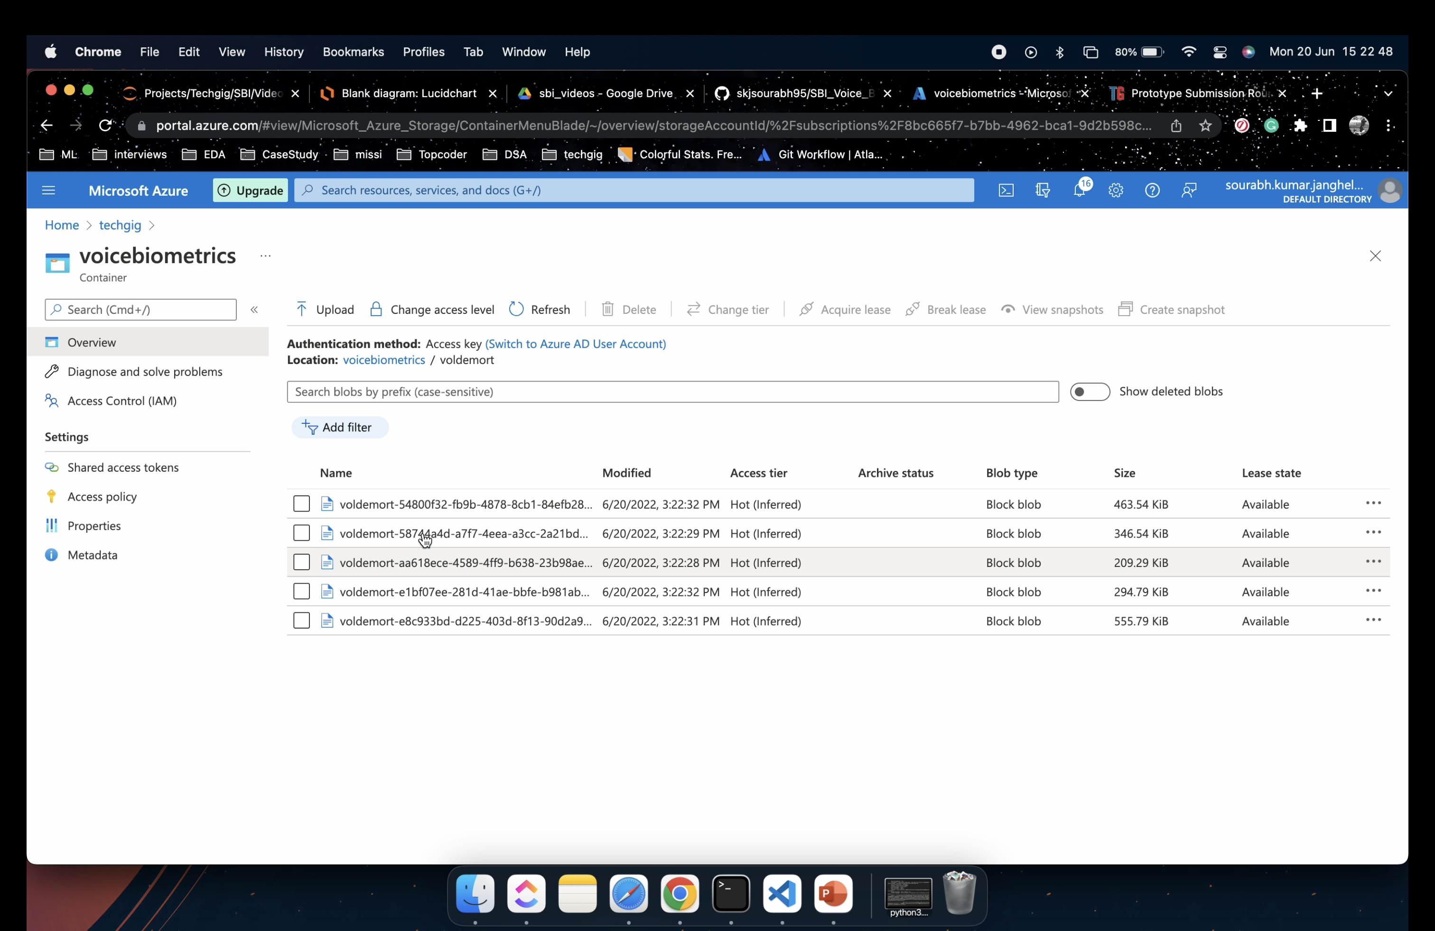

Slide 17
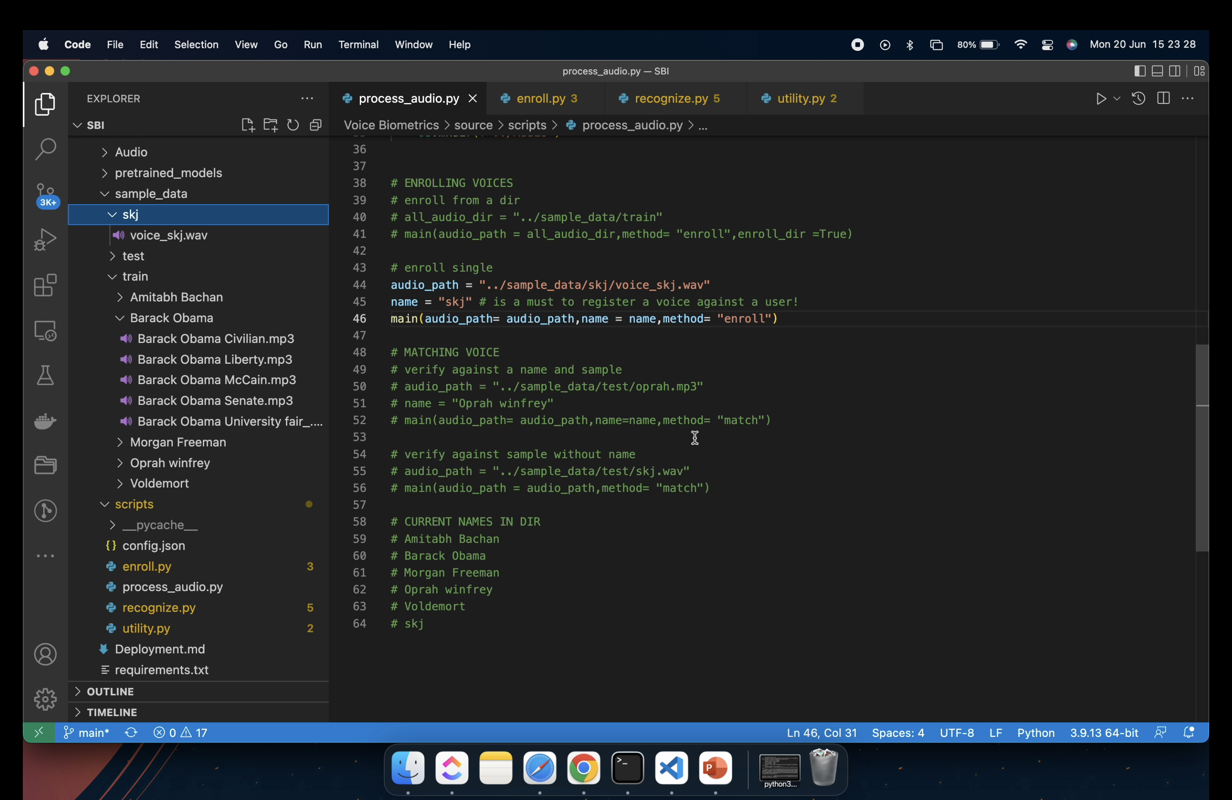
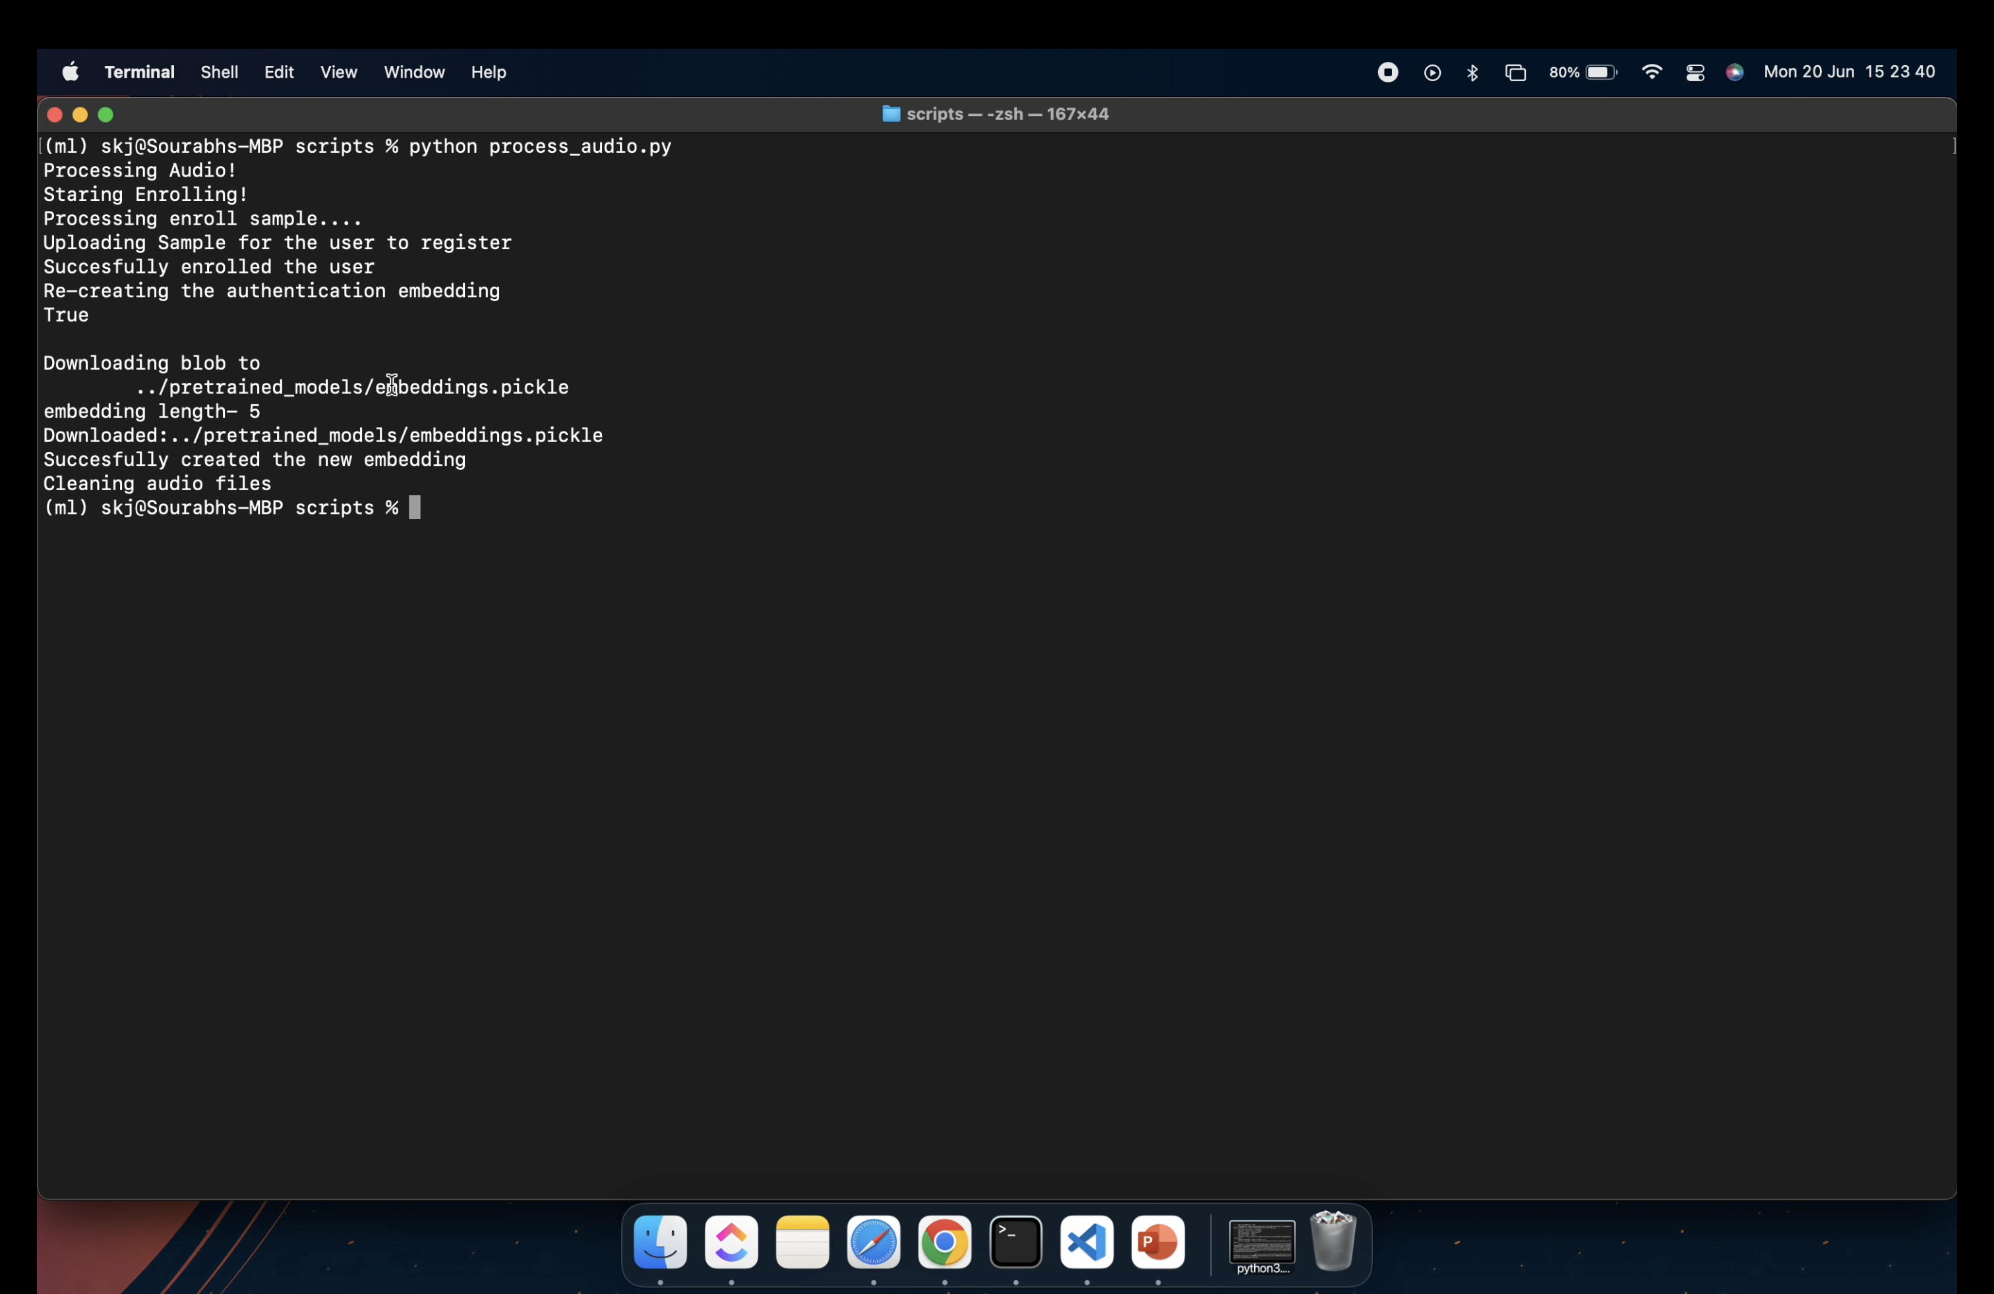
Enroll a single vocie with a name

Slide 18
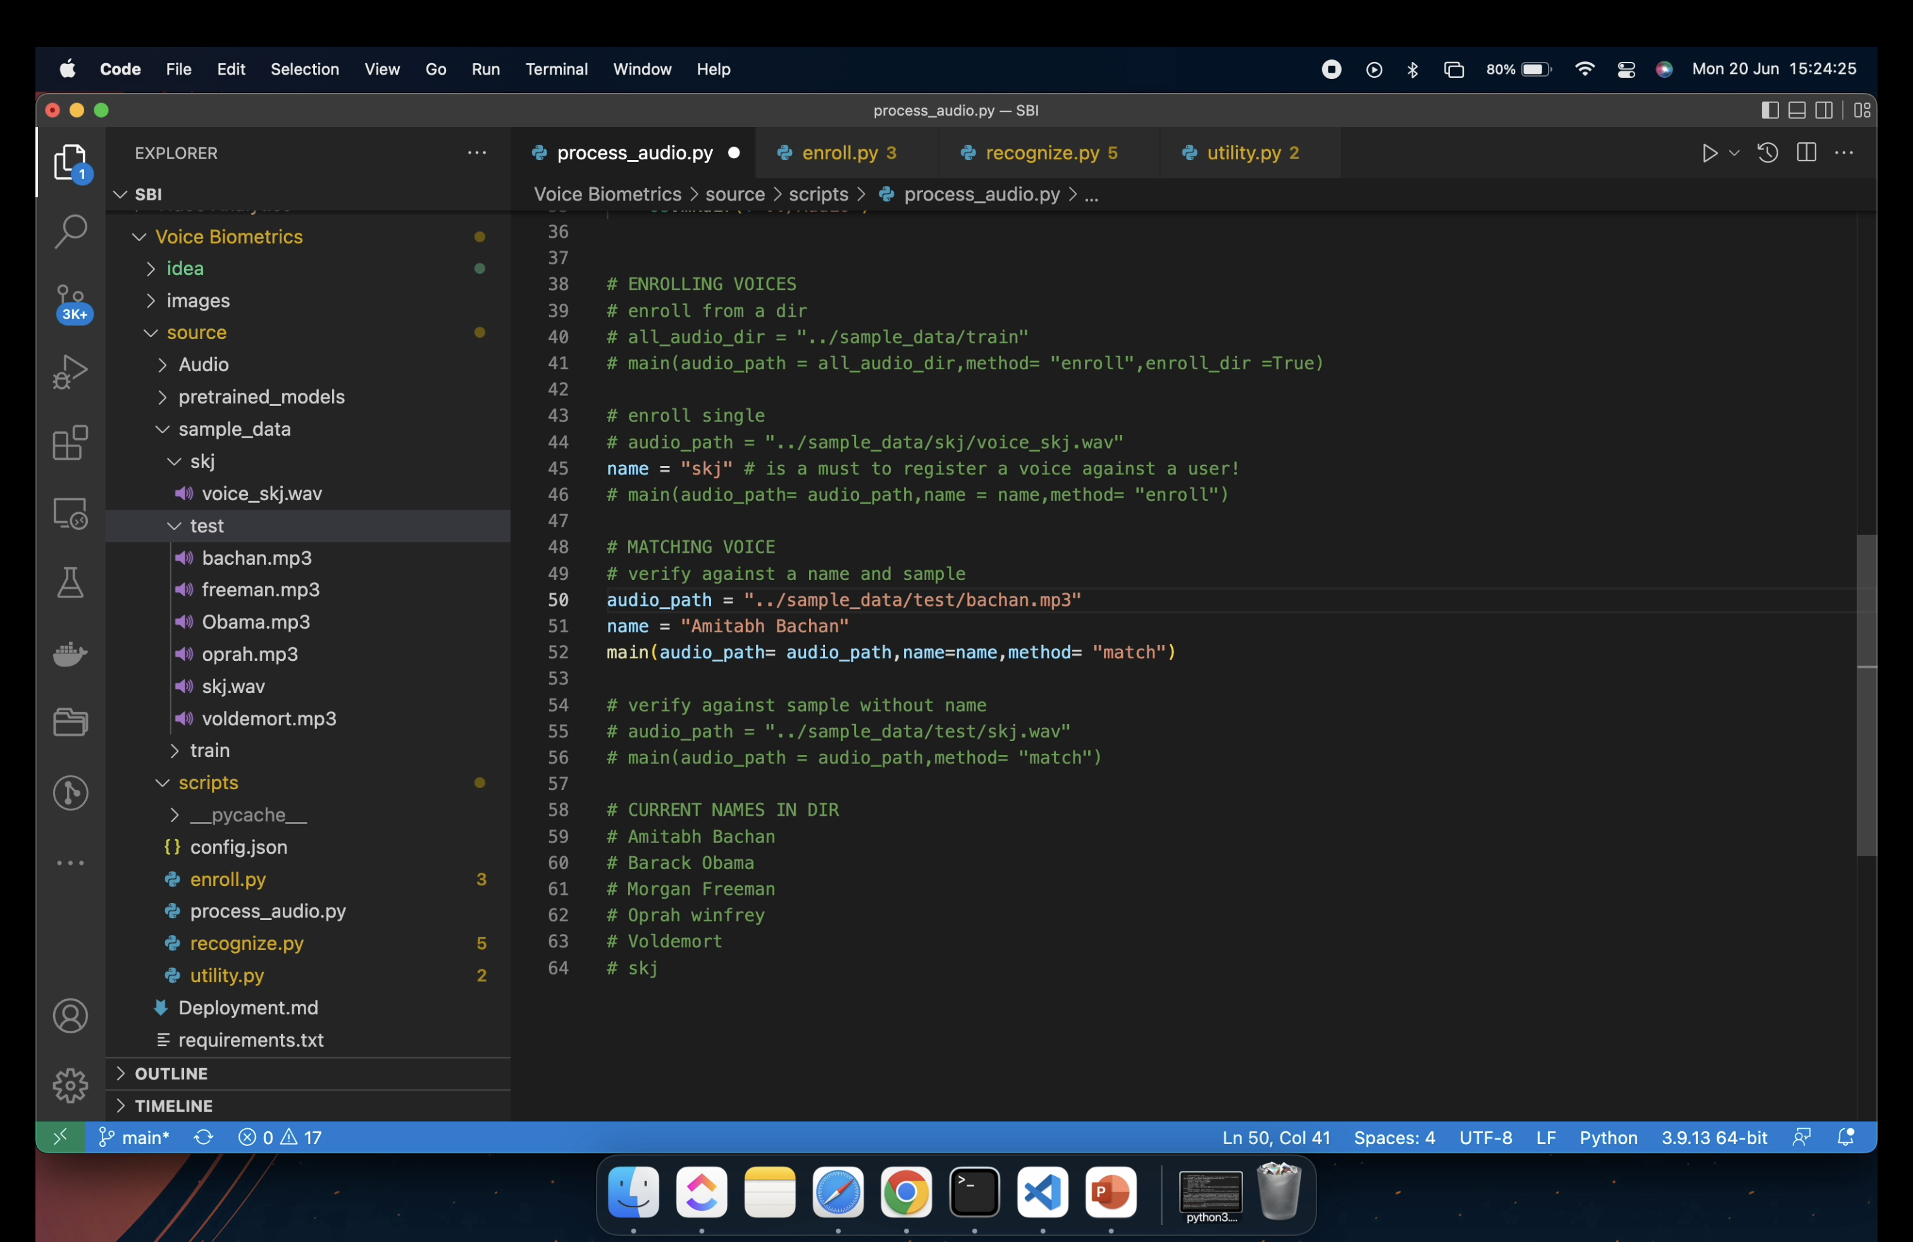
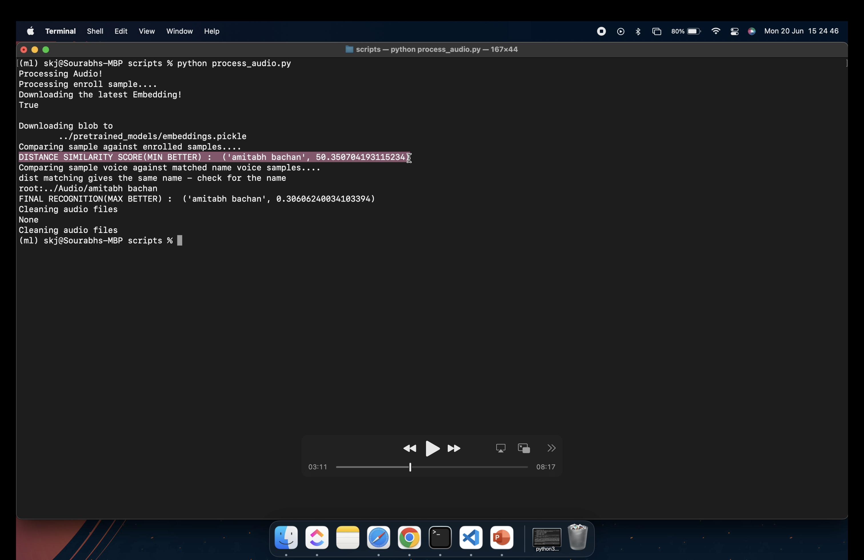
Match Voice with a given name
Distance Scoring Output matches with given name

Slide 19

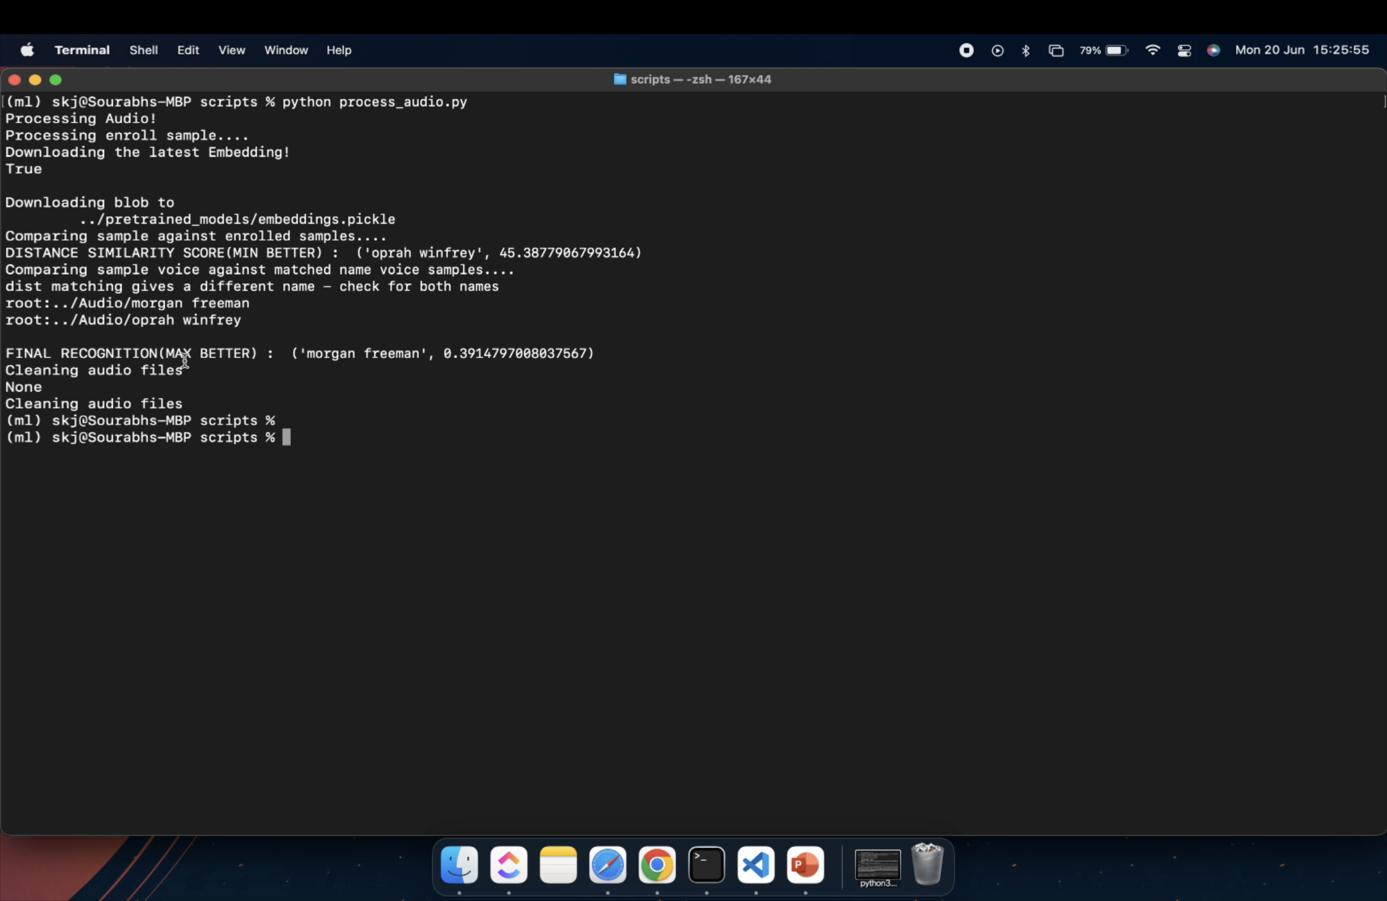
Match Voice with a given name
when Distance Scoring Output do not match with given name

Slide 20
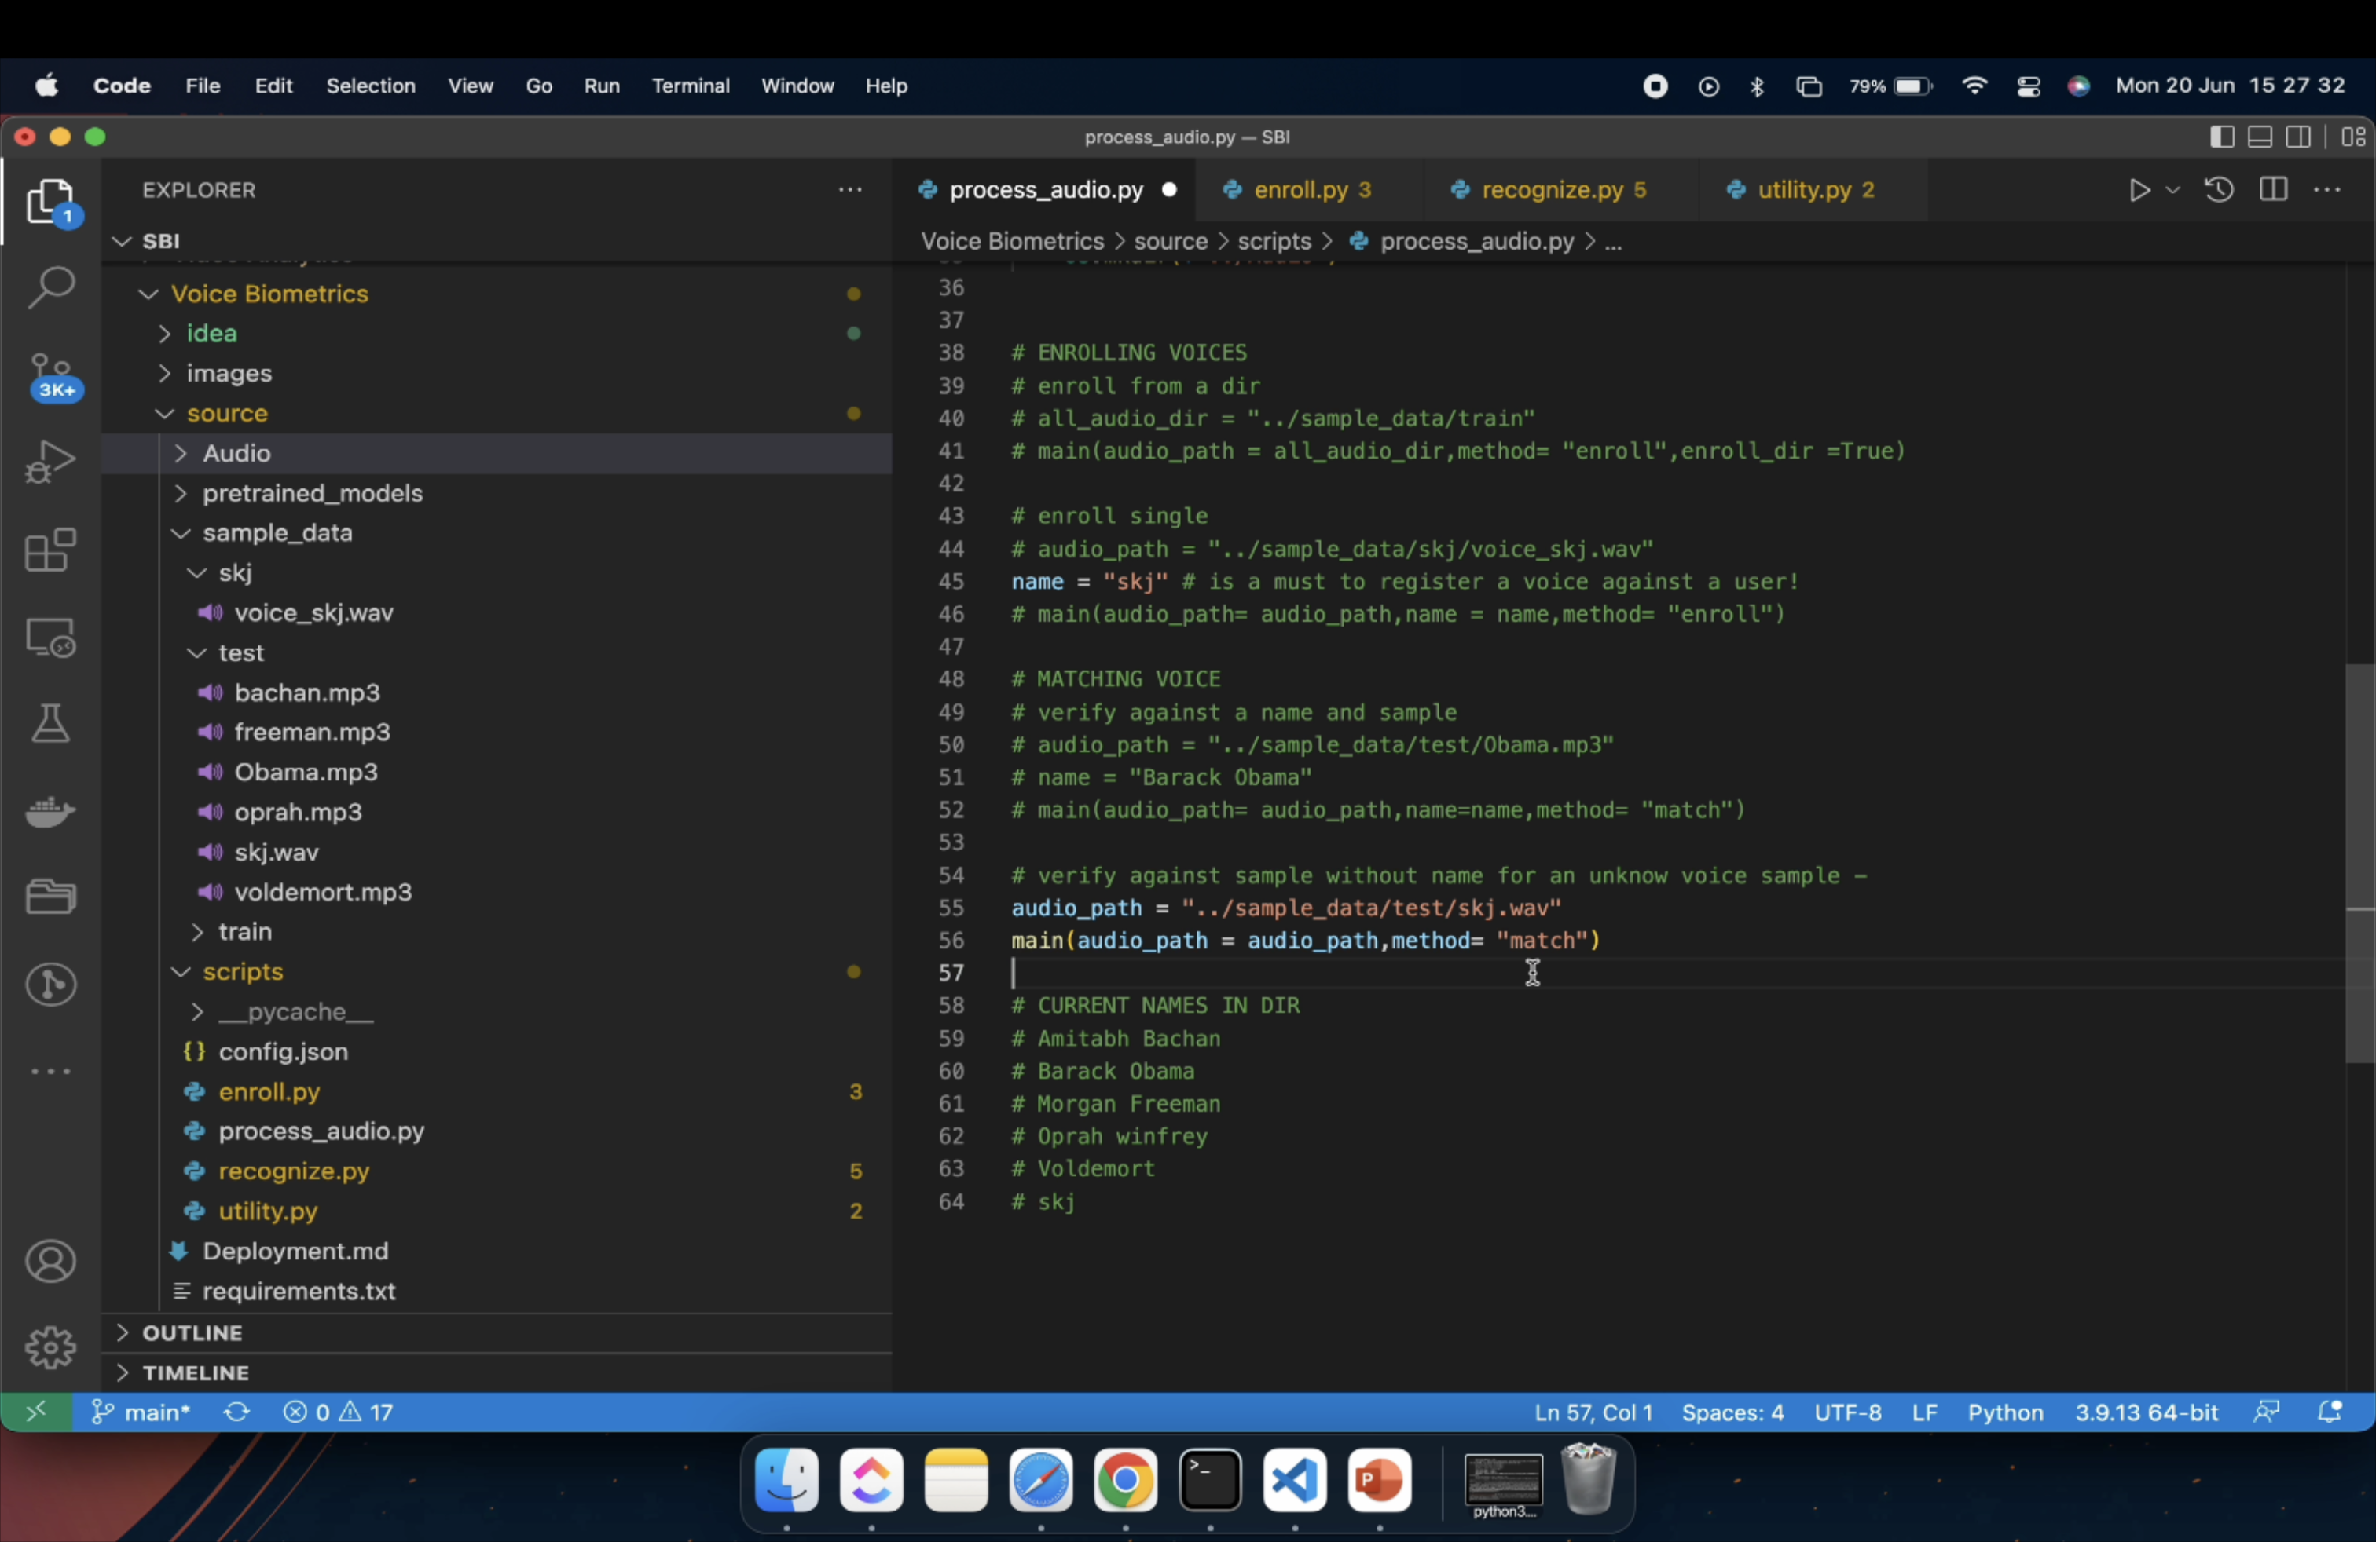
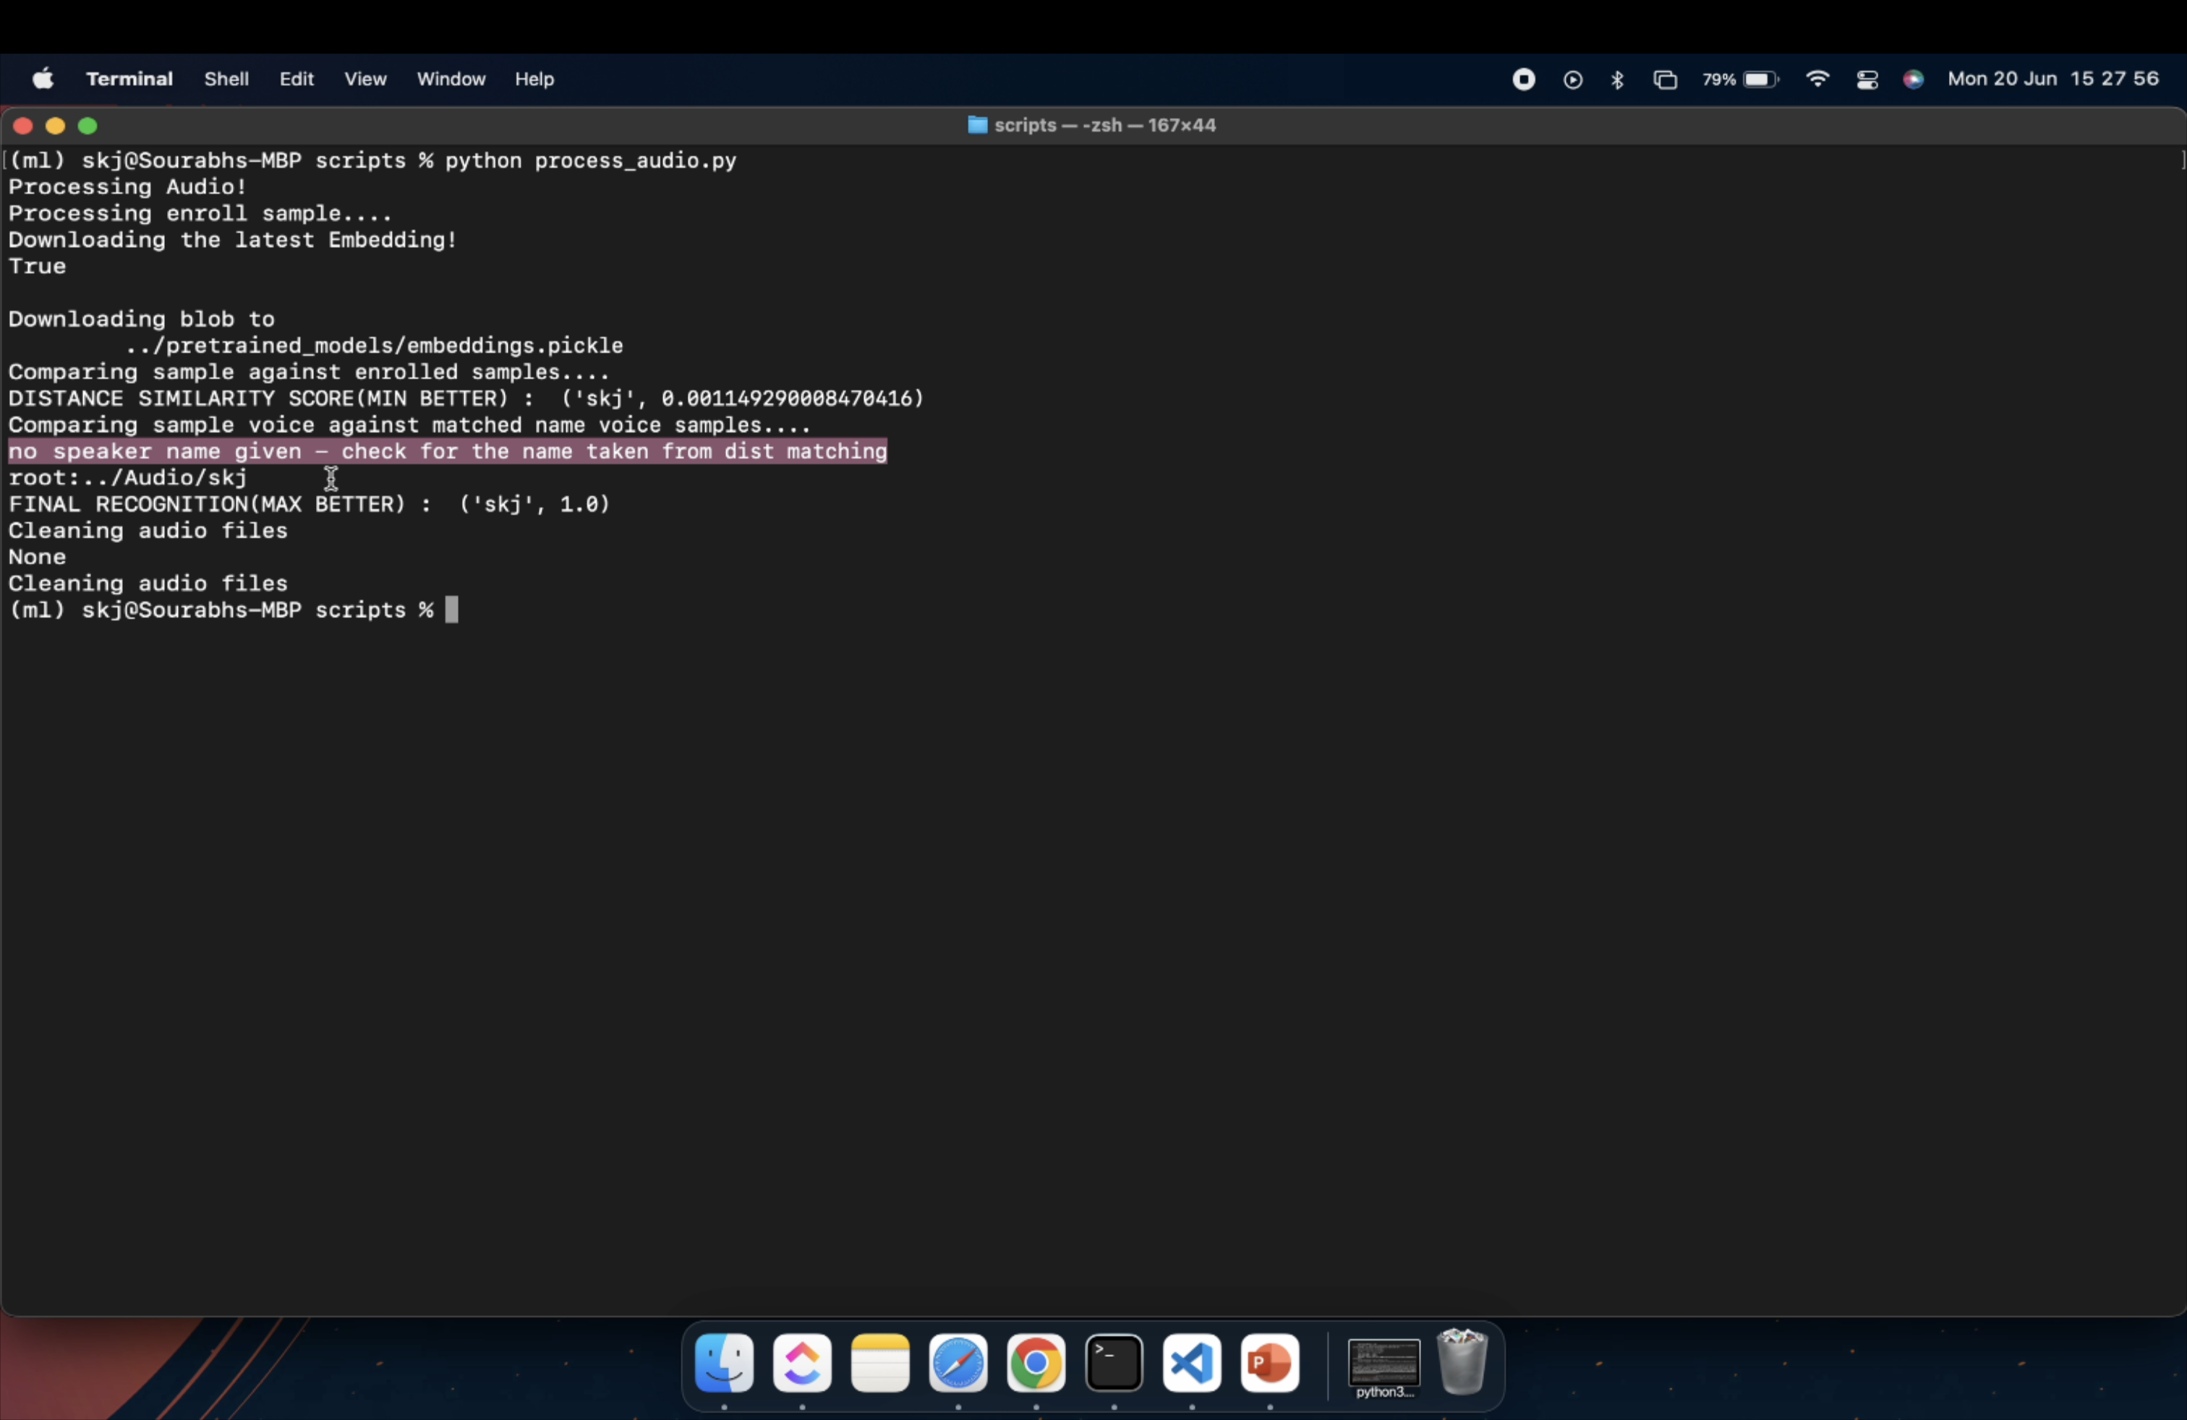
Match Voice without a given name

Slide 21
Summary
6
A write-up on why your application /solution should be considered

Slide 22
Why the solution should be considered?
The below points can be considered for my submission:
Enroll vocies with names from a directory or just a single voice with name
Identification of both known and unknown voices.
Using a similarity to match a audio to get recommended names and then verifying voices for those names seems a good idea since we can't do an online training of the model for each voice added, can be too costly.
We can keep adding new voices for a given user that increases the chances of being matched thus increasing confidence score and then after we have enough samples we can train a custom classifier model.
Used the best xvector model (trained on Voxceleb and stored on HuggingFace) From Speechbrain to compute voice embeddings and perform a speaker classification based on similarity scores to get a name of speaker which is lightweight and fast
Can handle huge audios with long lengths
Azure Functions for parallel processing of videos and scaling

Slide 23
Scaling
7
Ability to scale-up in enterprise grade environment

Slide 24
The Solution Can be dockerised and deployed as a HTTP Azure function
AZURE Functions
100% Scalable
That’s a easy serverless way of running the solution on cloud
instances of the Functions host are dynamically added and removed based on the number of incoming events.
Automatically scales based on demand using pre-warmed workers, which run applications with no delay after being idle, runs on more powerful instances, and connects to virtual networks
Total success!

Slide 25
Video Demo
Please Find the Link of the video here.

Slide 26
THANKS!
Any questions?
You can find me at
sourabh.kumar.janghel@outlook.com
@sourabhkumarjanghel

Slide 27

WANT BIG IMPACT?
USE AZURE CLOUD!

